Slide 1
Access Control & Cryptography

Slide 2
Access Control
Based on Authentication
Authentication is proving identity
A Token and a Password would be considered the most secure authentication method.
Can be based on any (or all) of the following:
Something you Know (e.g., a password)
Something you Have (e.g., ATM card, Access Token)
Something you Are (e.g., finger print, retina scan)

Slide 3
Single Factor Authentication
What you want to authenticate
User name
Something you know:
Password
In this case you may know two things, but it is the password that proves who the user is.

Slide 4
Multi-Factor Authentication
Smart Card, Security Token and PIN
The card is something you HAVE
The PIN is something you KNOW
Biometrics (example: fingerprint scan)
Biometrics - What you ARE, not what you KNOW.
The fingerprint is something you ARE
Your password is something you KNOW
A fingerprint scan or a retina scan would only be single factor authentication if you don’t have to put in a PIN or password
-c

Slide 5
Chapter 8
Cryptography
-av

Slide 6
Definitions
Cryptography: process of making and using codes to secure transmission of information
Cryptanalysis: process of obtaining original message from encrypted message without knowing algorithms
Cryptology: science of encryption; combines cryptography and cryptanalysis
Notes:
Cryptography and Encryption-Based Solutions
Although not a specific application or security tool, encryption represents a sophisticated approach to security that is implemented in many security systems.
In fact, many security-related tools use embedded encryption technologies to protect sensitive information handled by the application.
Encryption is the process of converting an original message into a form that is unreadable by unauthorized individuals, that is, anyone without the tools to convert the encrypted message back to its original format.
The science of encryption, known as cryptology, encompasses cryptography, from the Greek words kryptos, meaning hidden; graphein, meaning to write; and cryptanalysis, the process of obtaining the original message (or plaintext) from an encrypted message (or ciphertext), without the knowledge of the algorithms and keys used to perform the encryption.

Slide 7
Terminology
Clear Text or Plain Text
Any file or document that is unchanged and readable by the application that created it.
Cipher Text
A file or document that has been coded so that it cannot be read without conversion
Encryption
Converting Clear text to Cipher Text
Decryption
Converting Cipher Text back to Clear Text

Slide 8
A Different C.I.A.
Confidentiality: Keeping Data Secret
Use Encryption
Integrity: Knowing data hasn’t been altered
Use with Hashes
Authenticity: Knowing who sent the message
Use Certificates & Digital Signatures

Slide 9
Simple Encryption Example
One simple form of encryption is substitution cipher
Clear text: HELLO
Algorithm: Substitute letters by Key characters to the right in the alphabet
Key: 1
Encryption: A+1=B, B+1=C,… Z+1=A
Cipher text: IFMMP
Both Sender and Receiver must use the same algorithm and have copies of the Key

Slide 10
Encryption Example
Caesar Cipher : an example of a simple alphabet substitution cipher where the key is 3.
A is changed to D, B is changed to E and so on…
Algorithm (What to do) = Substitute by a character some numbers to the right
Key = 3

Slide 11
Encryption Keys
Symmetric Encryption
Secret Key
Shared Secret Key
If friend sends you an encryption key. Later he encrypts a message with an exact copy of the key he has kept. You decrypt the message with the key you received. This is an example of Symmetric Encryption.
Asymmetric Encryption
Requires two different keys to encrypt and decrypt data
Public/Private Key Pairs

Slide 12
Symmetric Keys
The same key can encrypt and decrypt
Sender and Receiver have identical keys
Much faster than Asymmetric encryption
Generally short lived (for added security)
Similar in concept to a password but much longer and more random.

Slide 13
Asymmetric Keys
Key Pairs
One Private Key
One Public Key
One key encrypts, the other decrypts
What the Private Key encrypts, only the Public key can decrypt.
What the Public Key encrypts, only the Private Key can decrypt

Slide 14
How Asymmetric Encryption Works

Slide 15
Santa uses Acme (Secret Flying Reindeer Feed Mix)
acme.com
North Pole

Slide 16
Santa’s Dilemma: Getting a confidential message to Acme
acme.com
North Pole
Clear Text
-------
-------
Clear Text
-------
-------

Slide 17

Santa’s Dilemma: Plain Text can be Intercepted and Read
acme.com
North Pole
Grinch
Plain Text
-------
-------
Clear Text
-------
-------
Clear text
-------
-------

Slide 18

Public/Private Key Pairs
acme.com
North Pole
Grinch
Private
Private
Public
Public

Slide 19
Santa Sends His Public Key
acme.com
North Pole
Grinch
Private
Private
Public
Public

Slide 20
Public Keys are not Secret
acme.com
North Pole
Grinch
Private
Private
Public
Public

Slide 21
Acme Sends Their Public Key
acme.com
North Pole
Grinch
Private
Private
Public
Public
Public
Public
Public
Public

Slide 22
Keys have been Exchanged
acme.com
North Pole
Grinch
Private
Private
Public
Public
Public
Public
Public
Public

Slide 23
Santa Encrypts Message with Acme’s Public Key
acme.com
North Pole
Grinch
Private
Private
Public
Public
Public
Public
Public
Public
XXXXXXXXXXXXXXXXXXXX
Clear Text
-------
-------

Slide 24
Message is transmitted over the insecure network
acme.com
North Pole
Grinch
Private
Private
Public
Public
Public
XXXXXXXXXXXXXXXXXXXX
Public
Public
Public
XXXXXXXXXXXXXXXXXXXX

Slide 25
Decryption Review
A message that was Encrypted with a Public key can NOT be decrypted with the Public key.
The message can ONLY be decrypted with the corresponding Private key.

Slide 26

Message is decrypted with Acme’s Private Key
Grinch
acme.com
North Pole
Private
Private
Public
XXXXXXXXXXXXXXXXXXXX
Public
X
Public
Public
Public
Public
Private
Clear Text
-------
-------
XXXXXXXXXXXXXXXXXXXX

Slide 27
Summary of Public/Private Key Operation
Grinch
acme.com
North Pole
Private
Private
Public
X
Public
XXXXXXXXXXXXXXXXXXXX
Public
Public
Public
Public
Clear Text
-------
-------
XXXXXXXXXXXXXXXXXXXX
XXXXXXXXXXXXXXXXXXXX
Clear Text
-------
-------
Transmit over the network
-C

Slide 28
Cipher Methods
Plaintext can be encrypted through bit stream or block cipher method
Bit stream: each plaintext bit transformed into cipher bit one bit at a time
Block cipher: message divided into blocks (e.g., 128 bits) and each is transformed into encrypted block of cipher bits using algorithm and key
Notes:
Cryptography and Encryption-Based Solutions
The notation used to describe the encryption process differs depending on the source.
The first uses the letters M to represent the original message, C to represent the ending ciphertext, and E to represent the encryption process: E(M) = C.
This formula represents the application of encryption to a message to create ciphertext. D represents the decryption or deciphering process, thus D[E(M)]=M.
K is used to represent the key, thus E(M, K) = C, or encrypting the message with the key results in the ciphertext.
Now look at a simple form of encryption based on two concepts: the block cipher and the exclusive OR operation.
With the block cipher method, the message is divided into blocks, i.e., 8- or 16-bit blocks, and then each block is transformed using the algorithm and key.
The exclusive OR operation (XOR) is a function of Boolean algebra whereby two bits are compared, and if the two bits are identical, the result is a binary 0. If the two bits are NOT the same, the result is a binary 1.

Slide 29
Cipher Methods
Substitution cipher: substitute one value for another
Monoalphabetic substitution: uses only one alphabet
Polyalphabetic substitution: more advanced; uses two or more alphabets
Vigenère cipher: advanced cipher type that uses simple polyalphabetic code; made up of 26 distinct cipher alphabets (see next slide)
Notes:
Encryption Operations
In encryption, the most commonly used algorithms include two functions: substitution and transposition.
In a substitution cipher, you substitute one value for another.
This is a simple enough method by itself but very powerful if combined with other operations. This type of substitution is based on a monoalphabetic substitution, since it only uses one alphabet.
More advanced substitution ciphers use two or more alphabets and are referred to as polyalphabetic substitutions.
Caesar reportedly used a three-value shift to the right, giving that particular substitution cipher his name–the “Caesar Cipher.”
Just like the substitution operation, the transposition cipher is simple to understand but can be complex to decipher if properly used.
Unlike the substitution cipher, the transposition cipher (or permutation cipher) simply rearranges the values within a block to create the ciphertext.
This can be done at the bit level or at the byte (character) level.
Transposition ciphers move these bits or bytes to another location in the block, so that bit 1 becomes bit 4, bit 2 becomes bit 7, etc.

Slide 30
Common Encryption Algorithms
Triple DES - Designed to replace the Data Encryption Standard (DES) algorithm and at one time TDES was the standard and the most widely used symmetric algorithm in the industry.
Triple DES uses three individual keys with 56 bits each and a total key length of 168 bits.
RSA is a public-key encryption algorithm and the standard for encrypting data over the internet. It is also a method used in PGP and GPG programs.
RSA is considered an asymmetric algorithm due to its use of a pair of keys. A Public key is used to encrypt a message, and a private key to decrypt it. The result of RSA encryption is good encryption that takes attackers quite a bit of time and processing power to break.
Blowfish - Designed to replace DES Blowfish splits messages into blocks of 64 bits and encrypts them individually. It’s known for both tremendous speed and overall effectiveness as many claim it has never been defeated. Blowfish is freely availability in the public domain.
Blowfish can be found in software categories ranging from e-commerce platforms for securing payments to password management tools, where it used to protect passwords. It’s definitely one of the more flexible encryption methods available.
Twofish is regarded as one of the fastest of its kind, and ideal for use in both hardware and software environments. Like Blowfish, Twofish is freely available to anyone who wants to use it.

Slide 31
Common Encryption Continued..
The Advanced Encryption Standard (AES) is the algorithm trusted as the standard by the U.S. Government and numerous organizations.
Although it is extremely efficient in 128-bit form, AES also uses keys of 192 and 256 bits for heavy duty encryption purposes.
AES is largely considered impervious to all attacks, with the exception of brute force, which attempts to decipher messages using all possible combinations in the 128, 192, or 256-bit cipher. Still, security experts believe that AES will eventually be hailed the de facto standard for encrypting data in the private sector.
The Future of Encryption
Expert observers are hopeful that a new method called Honey Encryption will deter hackers by serving up fake data for every incorrect guess of the key code. This unique approach not only slows attackers down, but potentially buries the correct key in a haystack of false hopes. Then there are emerging methods like quantum key distribution, which shares keys embedded in photons over fiber optic, that might have viability now and many years into the future as well.

Slide 32


Slide 33
Cipher Methods
Transposition cipher: rearranges values within a block to create cipher text
Exclusive OR (XOR): function of Boolean algebra; two bits are compared
If two bits are identical, result is binary 0
If two bits not identical, result is binary 1
Notes:
Transposition Cipher Method
The transposition cipher (or permutation cipher) simply rearranges the values within a block to create the ciphertext
This can be done at the bit level or at the byte (character) level. Transposition ciphers move these bits or bytes to another location in the block, so that bit 1 becomes bit 4, bit 2 becomes bit, 7 etc.

Slide 34
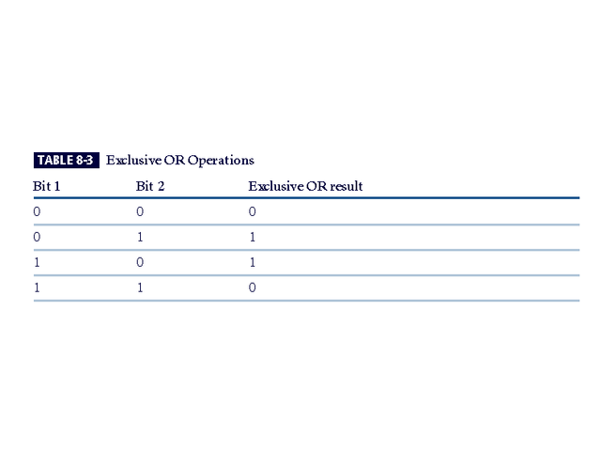
Exclusive OR Operations

Slide 35
Hash Functions
Mathematical algorithms that generate a unique number for any given input
Input = the thing you want to hash (letter, word, password, program, file)
Output (Hash or Message Digest) = number of set length
Hash algorithms: publicly known functions that create hash value
Notes:
Hash Functions
Hash algorithms are publicly known functions that create a hash value, also known as a message digest, by converting variable-length messages into a single fixed-length value.
The message digest is a fingerprint of the author’s message that is to be compared with the receiver’s locally calculated hash of the same message.
Hashing functions do not require the use of keys, but a message authentication code (MAC), which is essentially a one-way hash value that is encrypted with a symmetric key. The recipients must possess the key to access the message digest and to confirm message integrity.

Slide 36
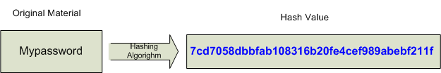
Hashing

Slide 37
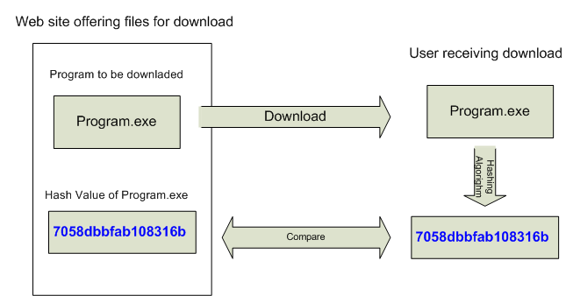
Hashing

Slide 38
Hashing Algorithim Examples
MD4
MD5
SHA-1
For example After you download the file you create an SHA-1 hash of the file and compare your value to the posted value. If they are the same, you know the file wasn’t corrupted during the download.
SHA-256
SHA-512
-C

Slide 39
Encryption Key Size
For cryptosystems, security of encrypted data is not dependent on keeping encrypting algorithm secret
Cryptosystem security depends on keeping some or all of elements of cryptovariable(s) or key(s) secret
Law #7: Encrypted data is only as secure as the decryption key*
* From Microsoft’s 10 Immutable Laws of Security,
http://www.microsoft.com/technet/archive/community/columns/security/essays/10imlaws.mspx?mfr=true
Notes:
Encryption Key Size
When using ciphers, one of the decisions that has to be made is the size of the cryptovariable or key. The strength of many encryption applications and cryptosystems is measured by key size.
When it comes to cryptosystems, the security of encrypted data is not dependent on keeping the encrypting algorithm secret; in fact, algorithms are often published, so that research to uncover their weaknesses can be done.
The security of any cryptosystem depends on keeping some or all of the elements of the cryptovariable(s) or key(s) secret.

Slide 40
Brute Force Attack Implications
Password Meets Complexity Requirements
6 characters, 94 possible choices (94^⁶)
6.9 X 10^¹¹ possible passwords
19 hours at 10 million hashes per second
(75 days for 7 characters, Server 2003 default)
(19 years for 8 characters)
Pass phrase “mypasswordstinks”
16 characters, only 26 possible choices (26^¹⁶ - lower case)
4.36 X 10^²² possible passwords
138 Million Years at 10 million hashes per second
If an attacker has obtained a list of password hashes. The Brute Force Attack is generally considered to take the longest.

Slide 41
Cracking Made Simple
In a 2012 Trustwave study (money.cnn.com) reported the following based on 2 million network vulnerability scans & 300 recent security breach investigations.
5% of passwords were variations on “password”
Password1 was the most popular password
2.1 million of 2.5 million passwords they tested were cracked with common password cracking tools
Exploiting weak passwords was the top method used and involved 29% of network breaches
More than 2/3 of companies didn’t know they had been breached until a 3rd party (such as law enforcement) notified them – allowing attackers network access for weeks or months!
A $1500 computer harvested 200,000 weak passwords in 10 hours using brute force

Slide 42
Digital Signatures
Encrypted messages that can be mathematically proven to be authentic
Created in response to rising need to verify information transferred using electronic systems
Asymmetric encryption processes used to create digital signatures
Notes:
Digital Signatures
An interesting thing happens when the asymmetric process is reversed, that is, the private key is used to encrypt a short message.
The public key can be used to decrypt it, and the fact that the message was sent by the organization that owns the private key cannot be refuted.
This is known as nonrepudiation, which is the foundation of digital signatures.
Digital signatures are encrypted messages that are independently verified by a central facility (registry) as authentic.

Slide 43
Digital Signatures (Signing)
Digital Signatures do not protect data (message content or payload) – they do NOT provide Confidentiality.
Digital Signatures prove Authenticity (who sent the message) (Nonrepudiation)
They use HASHs to provide Integrity (knowing the payload hasn’t changed)

Slide 44
Creating the Hash (Message Digest)
Hashing Algorithm
Such as MD5
Clear Text
Message or Data
Hash
Encryption With
Sender’s Private Key
Encrypted Hash
(Signature)

Slide 45
Sending the Signed Message
Clear Text
Message or Data
Sent to Destination
Encrypted Hash
(Signature)

Slide 46
Verifying the Message (At the receiving end)
Clear Text
Message or Data
Hashing Algorithm
Such as MD5
New Hash
Compare
Encrypted Hash
(Signature)
Hash
Decryption With
Sender’s Public Key
If the hashes are the same then you have verified
the author’s key and integrity of the data
-S

Slide 47
Digital Certificates
Digital certificates prove identity and include encryption keys and other information about the holder of the certificate
Many Microsoft Windows programs and services use certificates to provide security, including
The Kerberos authentication protocol
The Internet Protocol security (IPsec) extensions
The encrypting file system (EFS)
Internet Information Services (IIS)

Slide 48
What Is a Digital Certificate?
Digital certificates are the mechanisms used to distribute public keys over the network.
The main purpose of a certificate is to generate confidence that the public key contained in the certificate actually belongs to the entity named in the certificate.
A digital certificate consists of the public key itself, plus a collection of attributes that contains information about the owner of the public key.

Slide 49
Certificate Contents Examples
User (who was issued the certificate)
Example: Web site owner
Valid Dates (expiration date)
Public Key of the User
Issuer of the Certificate (CA)
Example: Verisign
Serial Number of the Certificate
What the certificate can be used for
Location of the CRL

Slide 50
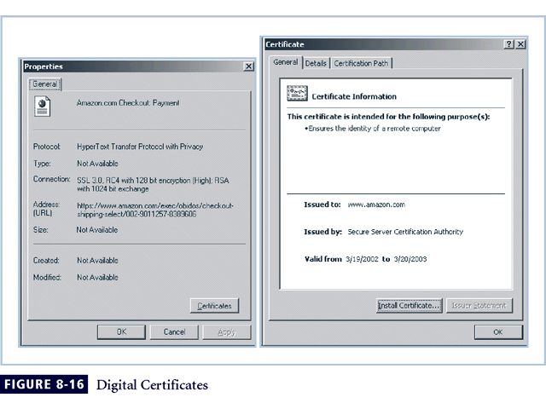
Figure 8-5 Digital Signatures

Slide 51
Hybrid Cryptography Systems
Except with digital certificates, pure asymmetric key encryption not widely used
Asymmetric encryption more often used with symmetric key encryption, creating hybrid system
Diffie-Hellman Key Exchange method: most common hybrid system; provided foundation for subsequent developments in public-key encryption
Notes:
Hybrid Systems
In practice, asymmetric key encryption is not widely used except in the area of certificates. Instead, it is more often used in conjunction with symmetric key encryption creating a hybrid system.
The current process is based on the Diffie-Hellman Key Exchange method, which is a way to exchange private keys without exposure to any third parties using public key encryption.
With this method, asymmetric encryption is used as a method to exchange symmetric keys so that two organizations can conduct quick, efficient, secure communications based on symmetric encryption.
Diffie-Hellman provided the foundation for subsequent developments in public key encryption.

Slide 52
Steganography
Process of hiding information in a graphic image code; in use for a long time
Most popular modern version hides information within files appearing to contain digital pictures or other images
Some applications hide messages in .bmp, .wav, .mp3, and .au files, as well as in unused space on CDs and DVDs
Notes:
Steganography
Steganography is a process of hiding information and has been in use for a long time.
The word “steganography” is derived from the Greek words steganos meaning “covered” and graphein meaning “to write.”
The most popular modern version of steganography involves hiding information within files that appear to contain digital pictures or other images.
Most computer graphics standards use a combination of three color values (red, blue, and green (RGB)) to represent a picture element, or pixel.
Each of the three color values usually requires an 8-bit code for that color’s intensity (e.g., 00000000 for no red and 11111111 for maximum red).
This inability to perceive difference on the part of humans provides the steganographer with one bit per color (or three bits per pixel) to use for encoding data into an image file.
Some applications are capable of hiding messages in .bmp, .wav, .mp3, and .au files, as well as in unused storage space on CDs and DVDs.

Slide 53
NTFS Hidden Data Streams
You can hide data in any file stored on an NTFS volume.
Hidden data does not increase the file size
Hidden data does not change the HASH !!!

Slide 54
Protocols for Secure Communications
Securing Internet Communication with S-HTTP and SSL
Secure Socket Layer (SSL) protocol: uses public key encryption to secure channel over public Internet. You might use this when making purchases on an Internet shopping site.
Secure Hypertext Transfer Protocol (S-HTTP or HTTPS): extended version of Hypertext Transfer Protocol; provides for encryption of individual messages between client and server across Internet.
S-HTTP (HTTPS) is the application of SSL over HTTP; allows encryption of information passing between computers through protected and secure virtual connection
Notes:
Securing the Web
Secure Electronic Transactions (SET) was developed by MasterCard and Visa in 1997 to provide protection from electronic payment fraud.
SET works by encrypting the credit card transfers with DES for encryption and RSA for key exchange, much as other algorithms do.
SET provides the security for both Internet-based credit card transactions and the encryption of swipe systems of those credit cards in retail stores.
Secure Socket Layer was developed by Netscape in 1994 to provide security in online electronic commerce transactions.
It uses a number of algorithms but mainly relies on RSA for key transfer and IDEA, DES, or 3DES for encrypted symmetric key-based data transfer.
Secure Hypertext Transfer Protocol (SHTTP) is an encrypted solution to the unsecured version of HTTP.
It provides an alternative to the aforementioned protocols and can provide secure e-commerce transactions as well as encrypted Web pages for secure data transfer over the Web, using a number of different algorithms.
Secure Shell (SSH) provides security over remote access connections using tunneling. It provides authentication services between a client and server.
IP Security (IPSec) is the cryptographic authentication and encryption product of the IETF’s IP Protocol Security Working Group, defined in RFC 1825, 1826 and 1827.
IP Security (IPSec) is used to create virtual private networks (VPNs) and is an open framework for security development within the TCP/IP family of protocol standards.

Slide 55
Protocols for Secure Communications
Securing e-mail with S/MIME, PEM, and PGP
Secure Multipurpose Internet Mail Extensions (S/MIME): builds on Multipurpose Internet Mail Extensions (MIME) encoding format by adding encryption and authentication
Privacy Enhanced Mail (PEM): proposed as standard to function with public-key cryptosystems; uses 3DES symmetric key encryption
Pretty Good Privacy (PGP): uses IDEA Cipher for message encoding
Notes:
Securing E-mail
A number of encryption cryptosystems have been adapted in an attempt to inject some degree of security into e-mail, a notoriously unsecured medium.
S/MIME builds on the Multipurpose Internet Mail Extensions (MIME) encoding format by adding encryption and authentication through digital signatures based on public key cryptosystems.
Privacy Enhanced Mail (PEM) was proposed by the Internet Engineering Task Force (IETF) as a standard to function with the public-key cryptosystems.
PEM uses 3DES symmetric key encryption and RSA for key exchanges and digital signatures.
Pretty Good Privacy (PGP) was developed by Phil Zimmerman and uses the IDEA Cipher, a 128-bit symmetric key block encryption algorithm with 64-bit blocks for message encoding.
IDEA performs eight rounds on 16-bit sub-blocks using algebraic calculations.
PGP also uses RSA for symmetric key exchange and for digital signatures.

Slide 56
Protocols for Secure Communications
Securing Wireless Networks with WEP and WPA
Wired Equivalent Privacy (WEP)
Wi-Fi Protected Access (WPA & WPA2): created to resolve issues with WEP
Next Generation Wireless Protocols: Robust Secure Networks (RSN), AES – Counter Mode Encapsulation, AES – Offset Codebook Encapsulation
Bluetooth: de facto industry standard for short range wireless communications between devices (30 ft. range which can be exploited by anyone unless suitable security controls are implemented

Slide 57
Protocols for Secure Communications
Securing TCP/IP with IPSec
Internet Protocol Security (IPSec): open source protocol to secure communications across any IP-based network
IPSec designed to protect data integrity, user confidentiality, and authenticity at IP packet level
Notes:
IPSec
IPSec combines several different cryptosystems including:
Diffie-Hellman key exchange for deriving key material between peers on a public network
Public-key cryptography for signing the Diffie-Hellman exchanges to guarantee the identity of the two parties
Bulk encryption algorithms, such as DES, for encrypting the data
Digital certificates signed by a certificate authority to act as digital ID cards.
IPSec includes:
1) The IP Security Protocol itself, which defines the information to add to an IP packet, as well as how to encrypt packet data
2) The Internet Key Exchange, which uses asymmetric-based key exchange and negotiates the security associations.

Slide 58
Defending Against Attacks
No matter how sophisticated encryption and cryptosystems have become, if key is discovered, message can be determined
Key management is not so much management of technology but rather management of people
-c
Notes:
Defending From Attacks
No matter how sophisticated encryption and cryptosystems have become, however, they have retained the same flaw that the first systems contained thousands of years ago: if you discover the key, you can determine the message.
Thus, key management is not so much the management of technology but rather the management of people.

